Slide 1
Understanding Bayesian Networks
Project Member: 1) Faaraan Farid Kazi
2) Shikshit Gupta
3) Rajendra Behera
Notes:
Speaker Notes
In this presentation, we will explore the world of Bayesian Networks (BNs), a powerful tool in artificial intelligence used to model uncertainties and make predictions. We will delve into their components, construction, and applications, and explore the exciting areas where BNs are making a difference.

Slide 2
What are Bayesian Networks?
Probabilistic graphical models that represent relationships between variables
Used to model uncertainty in complex systems
Enable reasoning and prediction under uncertainty
Notes:
Speaker Notes
Bayesian Networks are a type of probabilistic graphical model. They use a graphical structure to represent the relationships between variables in a system. Unlike traditional models, BNs excel at handling uncertainty, making them ideal for situations where complete information is not available. This allows us to reason about the system and make predictions even when faced with incomplete data.

Slide 3
Conditional Probability
The probability of an event occurring given another event has already occurred
Represented by P(B|A), where:
B is the dependent event
A is the independent event
Notes:
Speaker Notes
Conditional probability is a fundamental concept in BNs. It represents the likelihood of one event (B) happening, considering that another event (A) has already taken place. For example, the probability of it raining (B) given that there are dark clouds (A) is different from the probability of raining without considering the clouds. BNs leverage conditional probability to model the relationships between variables.

Slide 4
Components of Bayesian Networks
Nodes: Represent variables in the system (e.g., weather, sprinkler, grass wet)
Edges: Represent conditional dependencies between variables (directed arrows)
Notes:
Speaker Notes
The building blocks of BNs are nodes and edges. Nodes represent the variables in the system we are interested in, such as weather, sprinkler, or grass wet. Edges, depicted as directed arrows, represent the conditional dependencies between these variables. An arrow from node A to node B indicates that the state of A influences the probability of the state of B.

Slide 5
Conditional Probability Tables (CPTs)
Tables that store the conditional probability of each node given the states of its parent nodes
Capture the strength of the relationships between variables
Notes:
Speaker Notes
Conditional probability tables (CPTs) are the heart of BNs. Each node in a BN has its own CPT, which stores the conditional probability of that node being in a specific state given the combinations of states of its parent nodes (nodes with arrows pointing towards it). These tables essentially capture the strength and direction of the relationships between variables in the network.

Slide 6
Constructing a Bayesian Network
Identify relevant variables: Determine the key factors involved in the system of interest.
Specify conditional dependencies: Establish the directed relationships between the variables.
Quantify conditional probabilities: Populate the CPTs using expert knowledge or data analysis.
Notes:
Speaker Notes
Constructing a BN involves a three-step process:
Identifying relevant variables: This involves pinpointing the key factors that influence the system we are modeling.
Specifying conditional dependencies: We then determine how these variables relate to each other, establishing the directed dependencies using arrows in the network.
Quantifying conditional probabilities: Finally, we populate the CPTs with the conditional probabilities of each node given the states of its parent nodes. This information can be obtained from expert knowledge or data analysis.

Slide 7
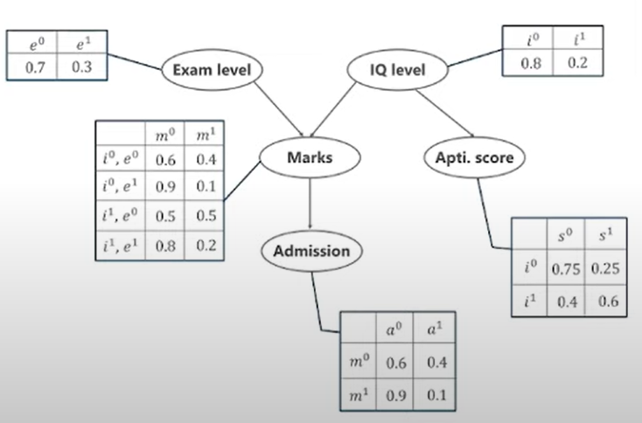
Create a Bayesian Network Model
The marks will depends on:
Exam Level (e): (Difficult, easy)
IQ of student (i): (high, low)
Marks -> admitted (a) to university
The IQ -> aptitude score (s) of the students
Pic Credit: Edureka.com

Slide 8
Application of Bayesian Networks
Medical Diagnosis:
Bayesian Networks are extensively used in medical diagnosis systems to assist healthcare professionals in diagnosing diseases.
By modeling the probabilistic relationships between symptoms, diseases, and patient demographics, Bayesian Networks can provide accurate diagnostic predictions.
For example, in diagnosing a patient's illness, a Bayesian Network can incorporate symptoms, medical history, test results, and demographic information to calculate the probability of various diseases.
These networks help prioritize diagnostic tests, reduce unnecessary testing, and improve patient outcomes by providing timely and accurate diagnoses.

Slide 9
Challenges and Solutions in Bayesian Networks
Solutions and Research:
Advanced Algorithms
Approximate inference methods (e.g., Markov Chain Monte Carlo, Variational Inference) for efficient computation.
Data-Driven Approaches
Machine learning techniques to estimate prior probabilities from data.
Hybrid Models
Integration with other probabilistic graphical models or deep learning architectures for scalability and accuracy.
Automated Model Construction
Tools and frameworks for automated model construction to aid in prior probability specification and reduce human bias.
Challenges:
Computational Complexity
High computational demands, especially with large networks or high-dimensional data.
Difficulty in Specifying Prior Probabilities
Subjective interpretation and lack of prior knowledge can lead to biased inference.

Slide 10
Thank You

